Slide 1

University Institute of Engineering
DEPARTMENT OF COMPUTER SCIENCE & ENGINEERING
Bachelor of Engineering (Computer Science & Engineering)
Subject Name : SEARCH ENGINE OPTIMIZATION
Subject Code: 20CST-463
Topic: Lecture-1.2.2
Lecture- Technical SEO
By : Sourabh Budhiraja
DISCOVER . LEARN . EMPOWER

Slide 2
Syllabus
UNIT-1: Introduction to Search Engine Optimization
CHAPTER-1: Introduction to Search Engine Optimization:
Understanding of search engines, Basics of SEO, Keyword Research, On-Page Optimization, Technical SEO.
CHAPTER-2: Content Creation and SEO tools:
Content Creation for SEO, SEO Analytics, SEO Tools, Local SEO, SEO Ethics and Future Trends.

Slide 3
CONTENTS
What is Search Engine Optimization?
Why is SEO important?
Types of SEO
What is Technical SEO?
Why is Technical SEO important?
Why should you optimize your site technically?
Characteristics of a technically optimized website.

Slide 4
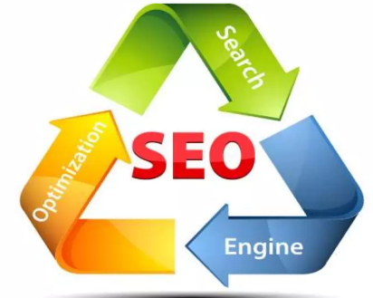
What is Search Engine Optimization?
SEO, which stands for Search Engine Optimization, is a crucial aspect of digital marketing and online visibility. It involves optimizing a website or online content to improve its visibility and ranking in search engine results pages (SERPs).
Fig. 1.2.2(a)

Slide 5
Why is SEO important?
To help gain more visitors: majority of users click on only the top 4-5 web pages appearing in search results, so it’s very important for a website to appear in the top results of a search engine.
Important for social promotion of a website: if a website appears in top results of a search engine such as Google, Bing, etc. then it gains instant popularity and to some extent trust of a user.
It plays an important role in improving the business of a commercial site: if two websites are selling the same product, for example, both Myntra and Koovs focus on selling fashion clothing, then the site having a better position in the search result of a search engine has chances of getting more users as compared to the other.
Improving user experience: SEO doesn’t focus only on improving search results but also on improving the user experience and usability of a website so that a website is more appealing to a user.

Slide 6
Types of SEO
There are mainly two types of SEO practices that are used for this purpose:
On-page SEO
Off-Page SEO
We also have another SEO,
Technical SEO

Slide 7
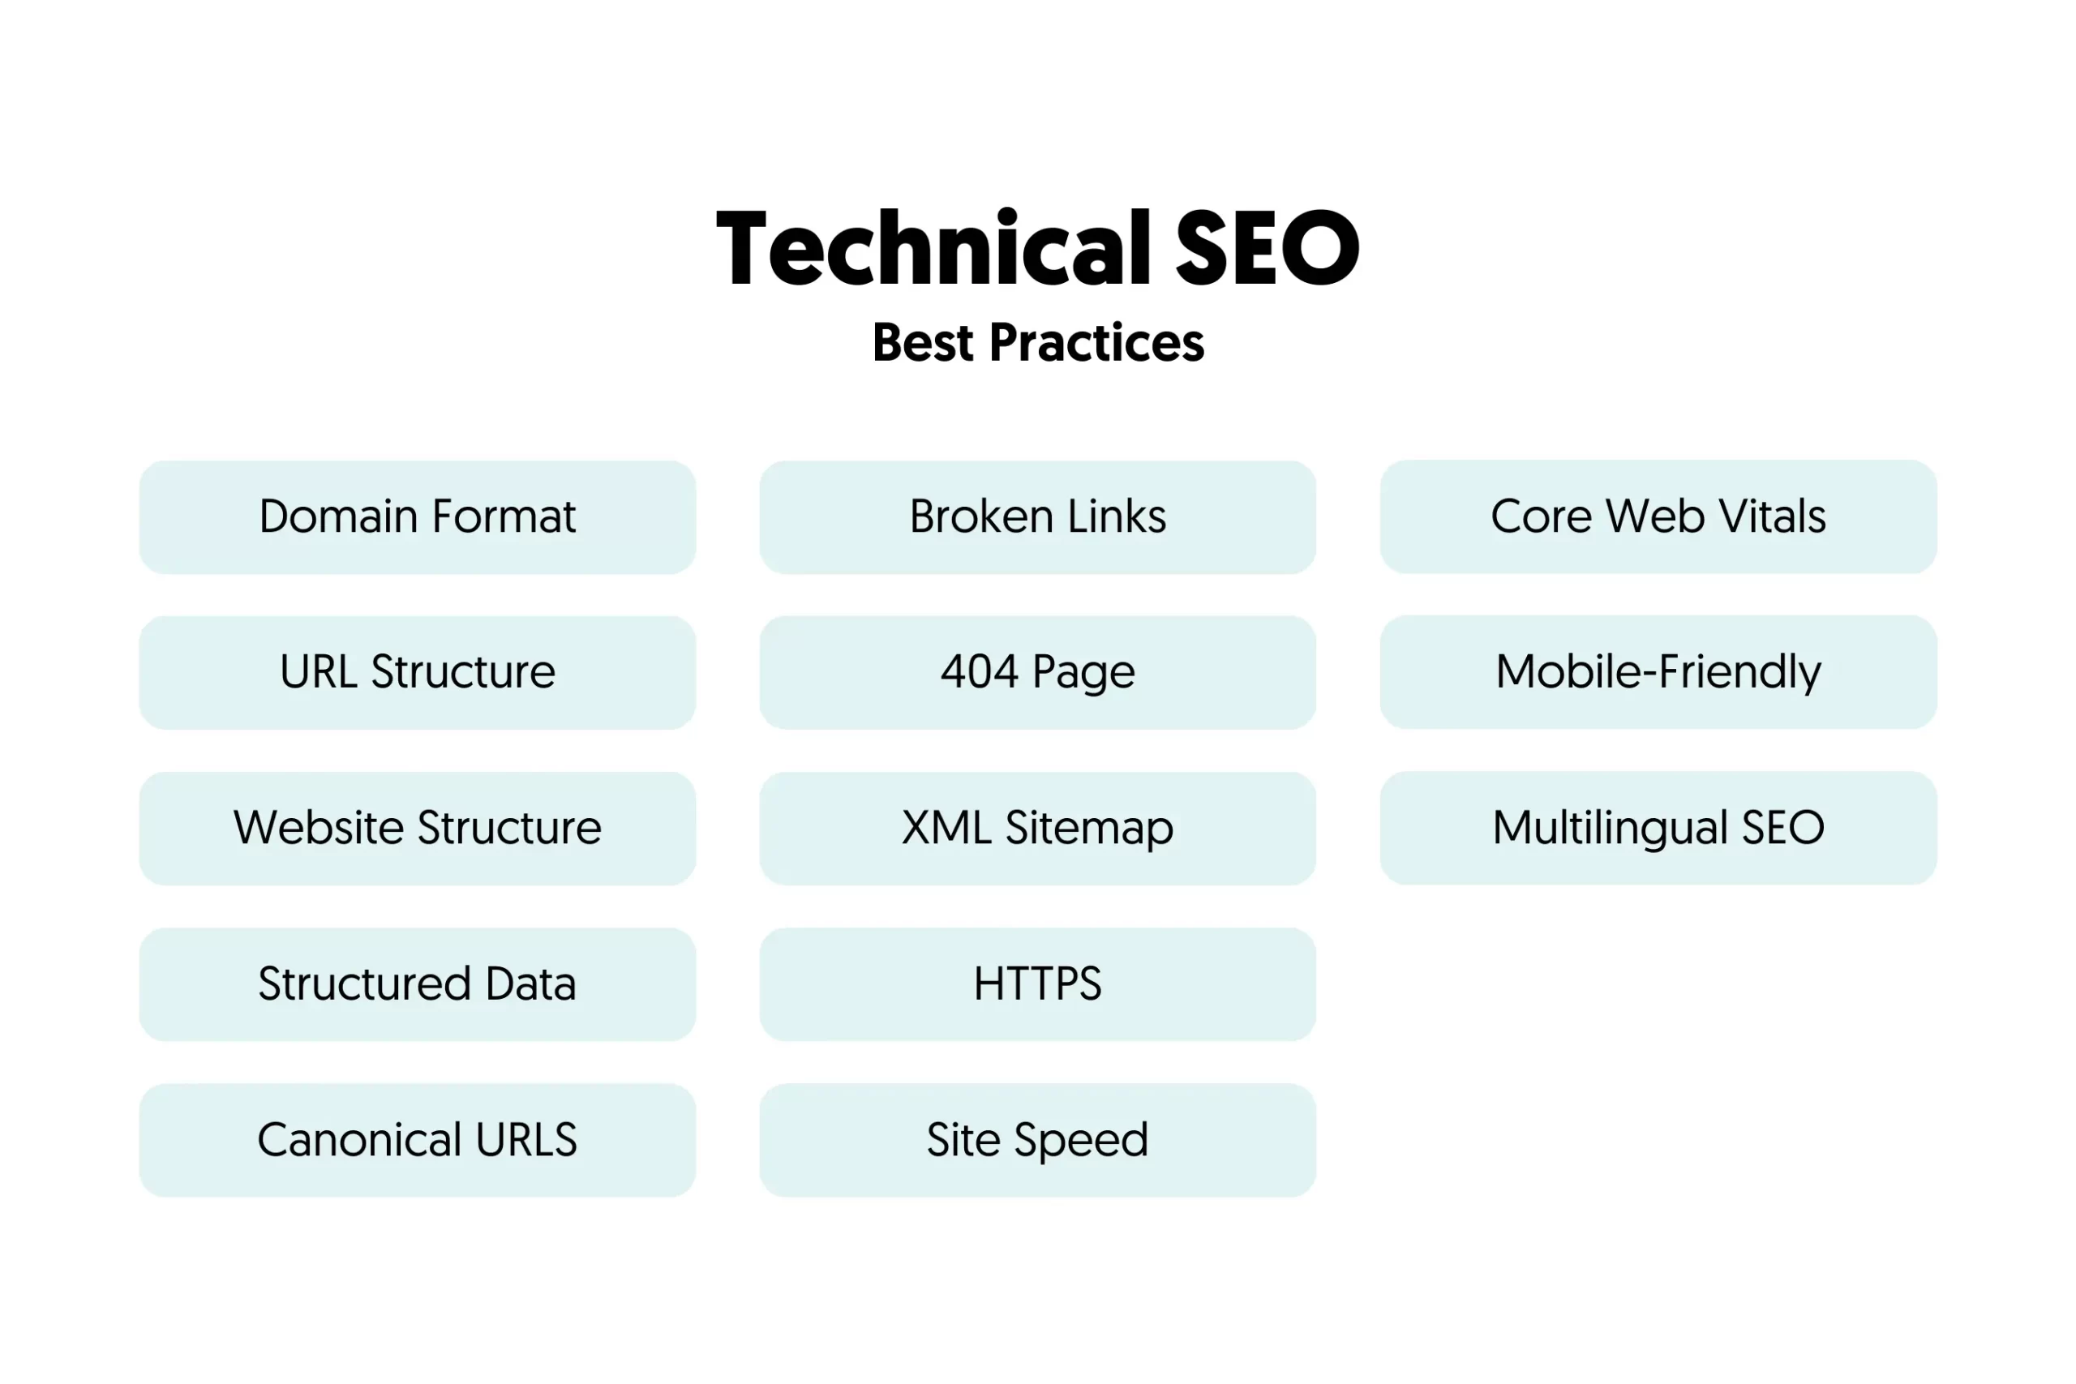
What is Technical SEO?
Technical SEO is the process of optimizing a website for search engines, but it can also include activities meant to improve user experience.
Fig. 1.2.2(b)

Slide 8
Why is Technical SEO important?
Technical SEO can greatly impact a website’s performance on Google. If pages on your site are not accessible to search engines, they won’t appear or rank in search results—no matter how valuable your content is. This results in a loss of traffic to your website and potential revenue to your business. Plus, the page speed and mobile-friendliness of a website are Google-confirmed ranking factors.
If your pages load slowly, users may get annoyed and leave your site. User behaviors like this may signal that your site doesn’t create a positive user experience. As a result, Google may not rank your site well.

Slide 9
Why should you optimize your site technically?
Google and other search engines want to present their users with the best possible results for their queries. Therefore, Google’s robots crawl and evaluate web pages on many factors. Some factors are based on the user’s experience, like how fast a page loads. Other factors help search engine robots grasp what your pages are about. This is what, among others, structured data does. So, by improving technical aspects, you help search engines crawl and understand your site. If you do this well, you might be rewarded with higher rankings. Or even earn yourself some rich results!

Slide 10
Characteristics of a technically optimized Website
A technically sound website is fast for users and easy to crawl for search engine robots. A proper technical setup helps search engines to understand what a site is about. It also prevents confusion caused by, for instance, duplicate content. Moreover, it doesn’t send visitors, nor search engines, to dead-ends caused by non-working links. Here, we’ll shortly go into some important characteristics of a technically optimized website.

Slide 11
Characteristics of a technically optimized Website
1. It’s fast
Nowadays, web pages need to load fast. People are impatient and don’t want to wait for a page to open. In 2016, research showed that 53% of mobile website visitors will leave if a webpage doesn’t open within three seconds. And the trend hasn’t gone away – research from 2022 suggests ecommerce conversion rates drop by roughly 0.3% for every extra second it takes for a page to load. So, if your website is slow, people get frustrated and move on to another website, and you’ll miss out on all that traffic.
2.It’s crawlable for search engines
Search engines use robots to crawl, or spider, your website. The robots follow links to discover content on your site. A great internal linking structure will ensure they understand the most important content on your site.

Slide 12
Characteristics of a technically optimized Website(Cont.)
3. Robots.txt file
You can give robots directions on your site by using the robots.txt file. It’s a powerful tool, which should be handled carefully. As we mentioned initially, a small mistake might prevent robots from crawling (important parts of) your site.
4. The meta robots tag
If you want search engine robots to crawl a page, but to keep it out of the search results for some reason, you can tell them with the robots meta tag.

Slide 13
Characteristics of a technically optimized Website(Cont.)
5. It doesn’t have (many) dead links
We’ve discussed that slow websites are frustrating. What might be even more annoying for visitors than a slow page, is landing on a page that doesn’t exist. If a link leads to a non-existing page on your site, people will encounter a 404 error page. There goes your carefully crafted user experience!
6. It doesn’t confuse search engines with duplicate content
Search engines might get confused if you have the same content on multiple pages of your site – or even on other sites. Because, if these pages show the same content, which one should they rank highest? As a result, they might give all pages with the same content a lower ranking.

Slide 14
Characteristics of a technically optimized Website(Cont.)
7. It’s secure
A technically optimized website is a secure website. Making your website safe for users to guarantee privacy is a basic requirement nowadays. You can do many things to make your (WordPress) website secure, and one of the most crucial things is implementing HTTPS.
8. Plus: it has structured data
Structured data helps search engines better understand your website, content, or business. With structured data, you can tell search engines what kind of product you sell, or which recipes you have on your site. Plus, it will allow you to provide details about those products or recipes.

Slide 15
Characteristics of a technically optimized Website(Cont.)
9.International websites use hreflang
If your site targets more than one country or multiple countries where the same language is spoken, search engines need a little help understanding which countries or languages you’re trying to reach. If you help them, they can show people the right website for their area in the search results.
10.It has an XML sitemap
Simply put, an XML sitemap is a list of all pages of your site. It serves as a roadmap for search engines on your site. With it, you’ll ensure search engines won’t miss any important content on your site. The XML sitemap is often categorized into posts, pages, tags, or other custom post types, and includes the number of images and the last modified date for every page.

Slide 16
Characteristics of a technically optimized Website(Cont.)
Hreflang tags help you do just that. You can use them to define which country and language each page is intended to serve. This also solves a possible duplicate content problem: even if your US and UK sites show the same content, Google will know they’re written for different regions.

Slide 17

Technical SEO Audit Fundamentals
Before you begin with your technical SEO audit, there are a few fundamentals that you need to put in place.
1. Audit Your Preferred Domain
Your domain is the URL that people type to arrive on your site, like hubspot.com. Your website domain impacts whether people can find you through search and provides a consistent way to identify your site.

Slide 18
Technical SEO Audit Fundamentals
2. Implement SSL
You may have heard this term before — that’s because it’s pretty important. SSL, or Secure Sockets Layer, creates a layer of protection between the web server (the software responsible for fulfilling an online request) and a browser, thereby making your site secure.
After you set up SSL, you’ll need to migrate any non-SSL pages from http to https. It’s a tall order, but worth the effort in the name of improved ranking. Here are the steps you need to take:
Redirect all http://yourwebsite.com pages to https://yourwebsite.com.
Update all canonical and hreflang tags accordingly.
Update the URLs on your sitemap (located at yourwebsite.com/sitemap.xml) and your robot.txt (located at yourwebsite.com/robots.txt).

Slide 19
Technical SEO Audit Fundamentals
Set up a new instance of Google Search Console and Bing Webmaster Tools for your https website and track it to make sure 100% of the traffic migrates over.
3. Optimize Page Speed
Do you know how long a website visitor will wait for your website to load? Six seconds ... and that’s being generous.

Slide 20
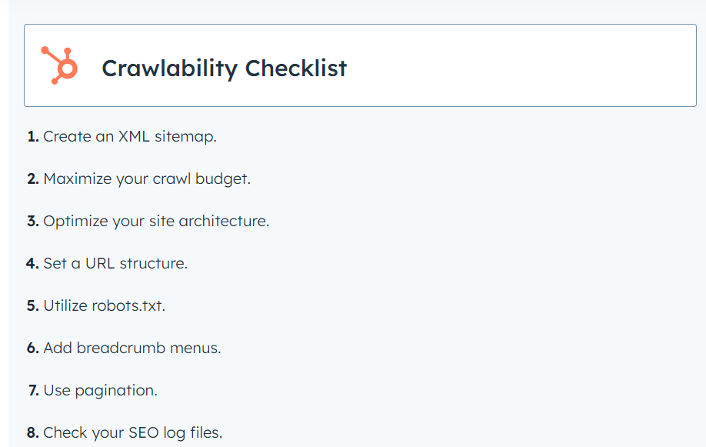
Technical SEO Audit Fundamentals
4. Crawlability Checklist
Crawlability is the foundation of your technical SEO strategy. Search bots will crawl your pages to gather information about your site.
Fig. 1.2.2(c)

Slide 21
References
Books and Journals
Eric Enge, Stephan Spencer, Rand Fishkin, Jessie C Stricchiola, “The Art of SEO : Mastering Search Engine Optimization”, O'Reilly Media, October,2009.
https://yoast.com/what-is-technical-seo/
Fhttps://www.startupgeeks.it/wp-content/uploads/2018/12/ebook-seo-sej-complete-guide-2018.pdf
Video Link-
https://www.youtube.com/watch?v=bLUkIgY8MTE&list=PLjVLYmrlmjGdNxIBIdaDEHtI4gAxaYoq1&ab_channel=WsCubeTech
https://www.youtube.com/watch?v=83RXYrqRLeM&list=PLNfnAKZ4Zsar3Jwb59D0dJeQ-RnsaqpoT&ab_channel=UmarTazkeer
Web Link-
https://www.geeksforgeeks.org/search-engine-optimization-seo/
https://www.tutorialspoint.com/seo/index.htm

